Slide 1
Distracted Drivers
By: Andrea, Payal, Andre, Eldar, Katherine, Cameron

Slide 2
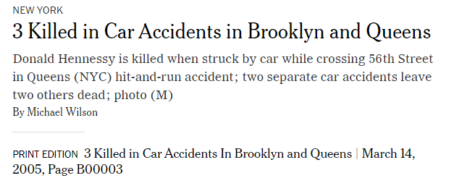
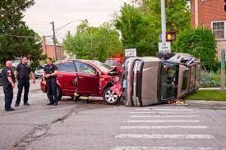
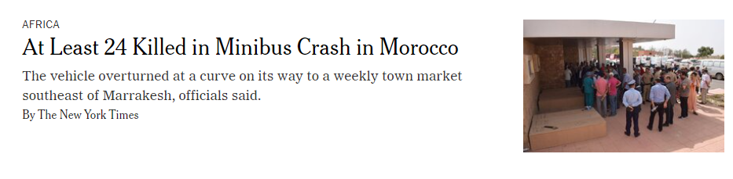
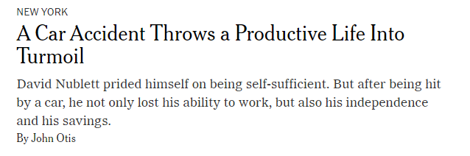
“Distracted driving is dangerous, claiming 3,522 lives in 2021” - United States Department of Transportation
The simple act of changing the music channel, checking your phone, or making a call can result in a life changing event for victims and the families
of victims of car accidents.
Our project is based
around detecting different
actions of distracted
driving so we are able to
alert the driver of the
distraction. We are looking
to build a model with the
highest accuracy in detection to hopefully prevent future accidents.

Slide 3
01
Building a Model

Slide 4
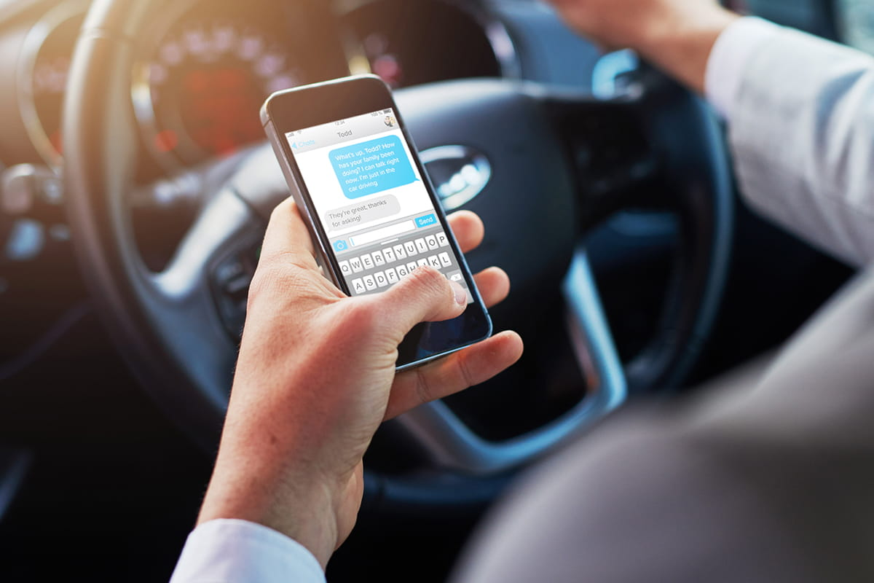
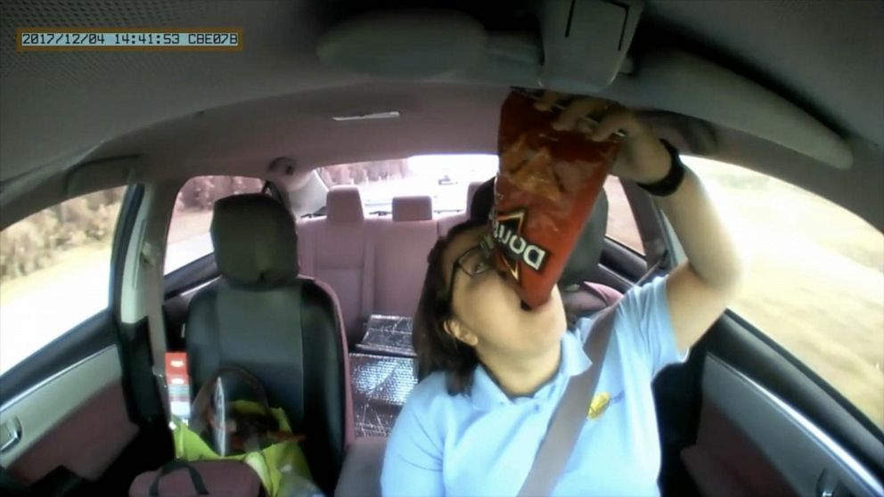
What is Our Data Source?
What Causes Distracted driving?:
Drinking Coffee
Tuning/changing the radio station
Using the mirror
What Doesn’t Cause Distracted driving?:
Attentive Driving

Slide 5
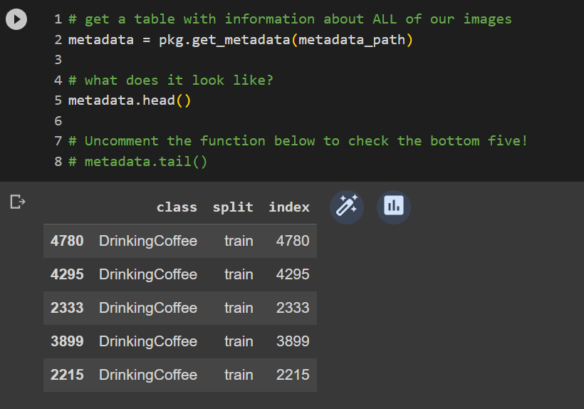
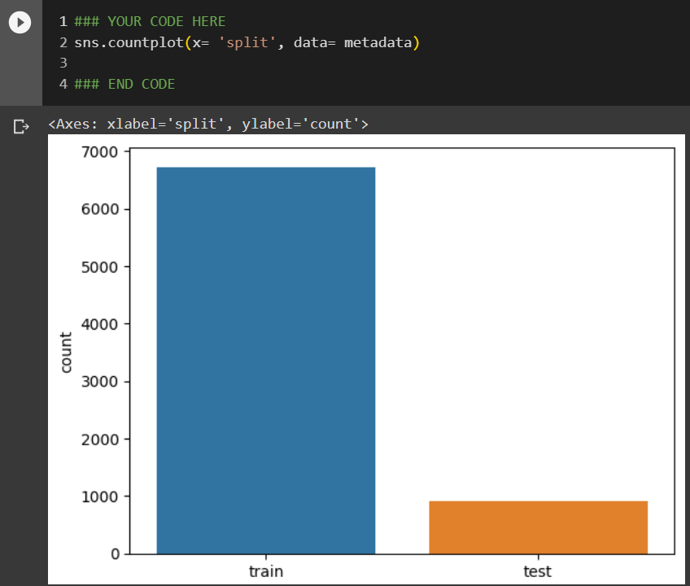
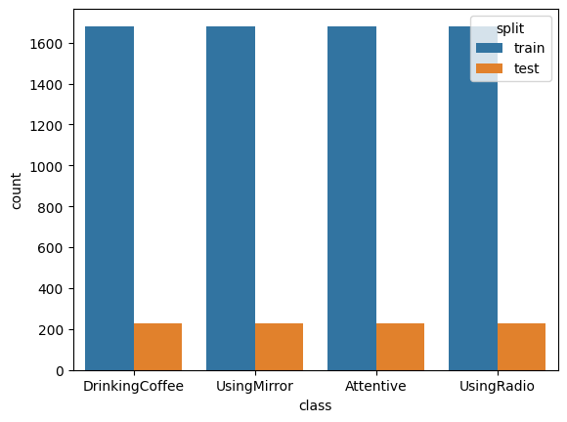
Looking at Our Data and Finding Differences
1)Import images in a data folder. The labels were Attentive,UsingRadio,DrinkingCoffee, and UsingMirror.
-Used metadata function that identifies class and the splits(training or testing; The data are images)
2)The identified splits covered all classifications. (80% train & 20% test)
-Using sns.countplot(x= ‘split’, data= metadata) created the graph.
3) By splitting our data for each class we were able to see they each had 80% training and 20% testing.
-We split our data by using hue= ‘split’
-We also want to keep the training and testing balanced to remove bias

Slide 6
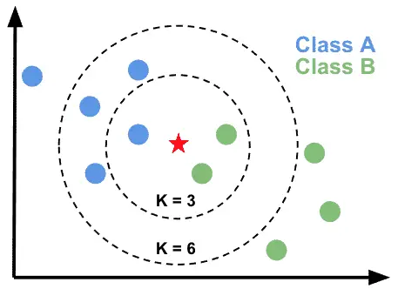
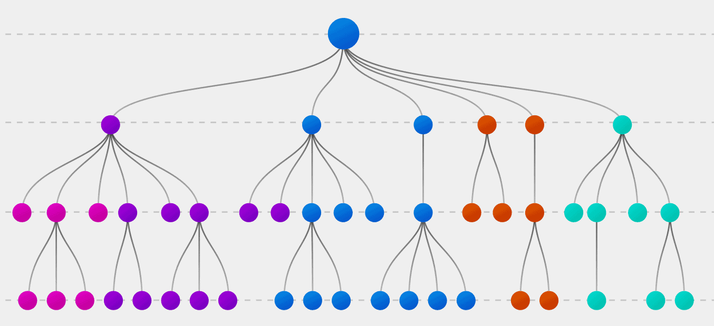
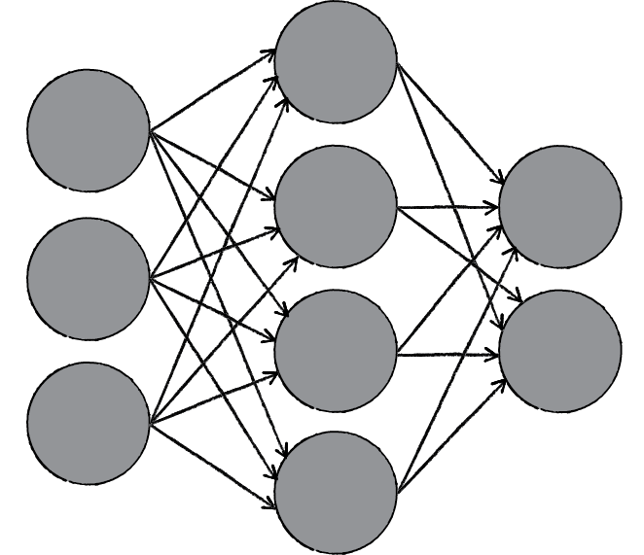
Choosing the Model
Inputs were images taken by cameras inside of cars that showed attentive and distracted drivers
Outputs were accuracy scores of how well the system predicted the images into the four types of driver situations
Below are the models we experimented with
KNeighbors:
Looks at a given number of similar images surrounding the input image and outputs the category it is most surrounded by
Decision Tree:
Makes one decision or another based on a set of rules it is given
Neural Networks:
Processes images pixels with different weighted filters and outputs the category it thinks the image best fits into
24.6%
50.8%
55.7%
Notes:
To decide the best model for our project, we had to understand what kind of data we wanted it to predict. The inputs were randomized images from what were captured by car cameras. The outputs had to be the accuracy scores of how well the system predicted the images into the 4 types of driver situations. This would be considered classification because the model is putting the images into categories. The models we experimented with were KNeighbors, Decision Tree, and Neural Networks. The best accuracy score influenced us to use that model due to it being most reliable. KNeighbors looks at a given number of similar images around the input and outputs the category it is most surrounded by. This gave us an accuracy score of 50.8% which isn’t the best but it demonstrates that the system can retain some of the training data during testing for a short time. Decision Tree makes one decision or another based a given set of rules so it makes sense that it gave us an accuracy of 24.6%. It was hard for the model to categorize the images if they could apply to multiple of the rules. The final one that we ended up using was Neural Networks. It processes images with different weighted filters, like neurons, and outputs the category it predicts the image would most fit into. With the accuracy score being 55.7%, we knew this model would be the most reliable.

Slide 7
02
Neural Networks

Slide 8
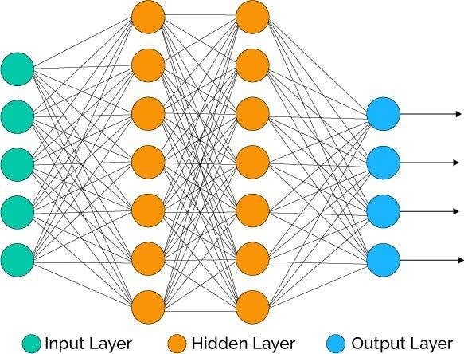
Understanding and building Neural Networks
A neural network is a computing model that uses algorithms to recognize patterns in data.
When building a neural network, we need to pay attention to:
The number of neurons
The activation of the neurons
The losses and metrics
Taking into account the information above, we needed to:
Specify the model
Add layers to the network
Turn the model on by compiling it

Slide 9

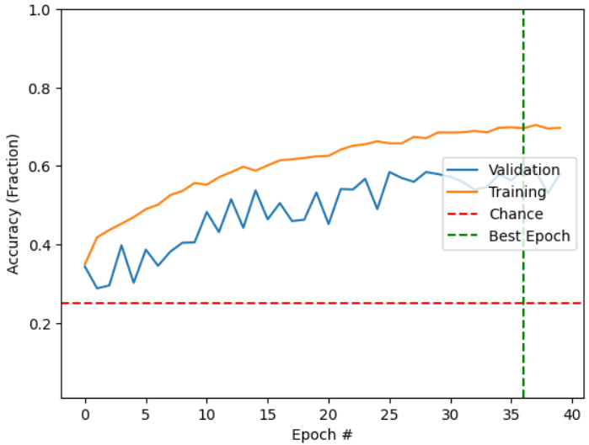
Applying Neural Networks
First, we built our model. Next, we augmented the data, trained our model, and then fit our data.
The model reached a peak validation accuracy of 58.7%

Slide 10
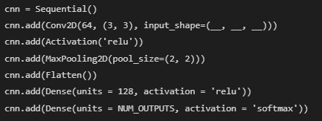

Exploring Convolutional Neural Networks
After completing the test run of the model, we have to ask ourselves;
Is this a good model?
Is it showing results of overfitting?
Shown here, the neural network architecture consists of one convolutional layer for extraction followed by two dense layers for high-level processing and prediction.
Through understanding the issues of the model and how we can improve it, we can use a convolutional neural network in order to improve our analysis of the model.
The model reached a peak accuracy of 64.67%. This shows much more improvement over what model was shown before.

Slide 11
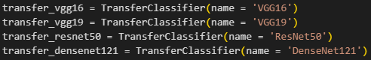
Expert Models
So far, we’ve used models that were made from scratch. However, just training on our data set alone, which is comparatively small to the amount of data in real world, is not enough for our accuracy to be satisfactional.
Fortunately, there are a few expert models that have trained on millions of images. We are able to use them for our purposes to get better predictions.
We have trained 4 expert models on our data and tested them head-to-head, using the same settings as before (using data augmentation and running 25 iterations).
(Trivia 1: these expert models were used on the ImageNet classification problem, where people were challenged to build a model that could distinguish 14 million images contained in more than 20 thousand categories.) (Trivia 2: the idea of using a model that trained on a different task as a starting point for our model is called transfer learning.)

Slide 12
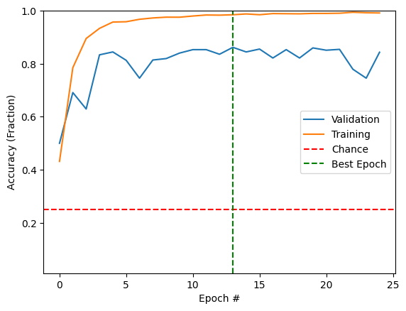
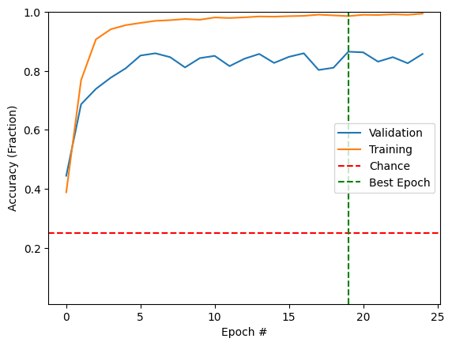
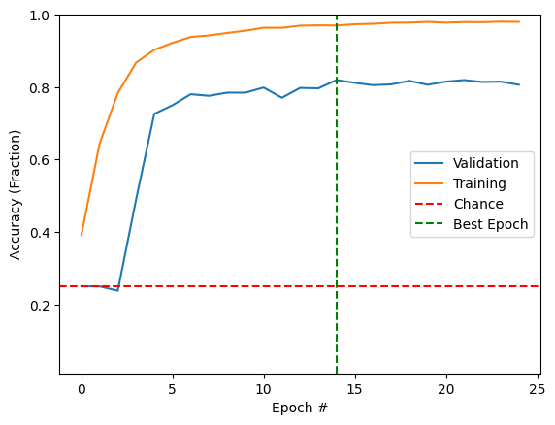
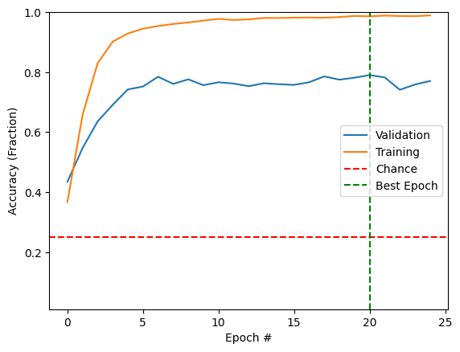
Accuracies
VGG16
(Best: 86.2%)
VGG19
(Best: 86.5%)
ResNet50
(Best: 81.9%)
DenseNet121
(Best: 79%)

Slide 13
03
A Closer Look at our Models
Notes:
Katherine

Slide 14
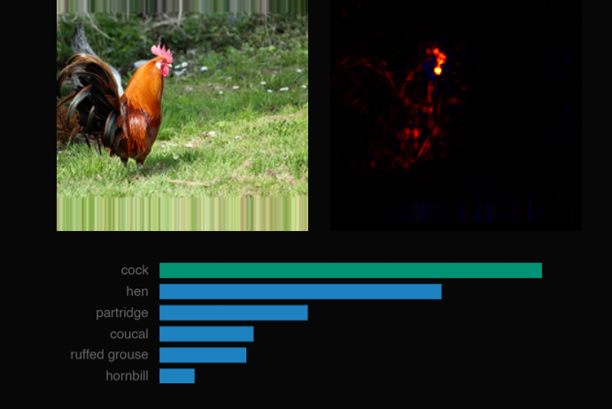
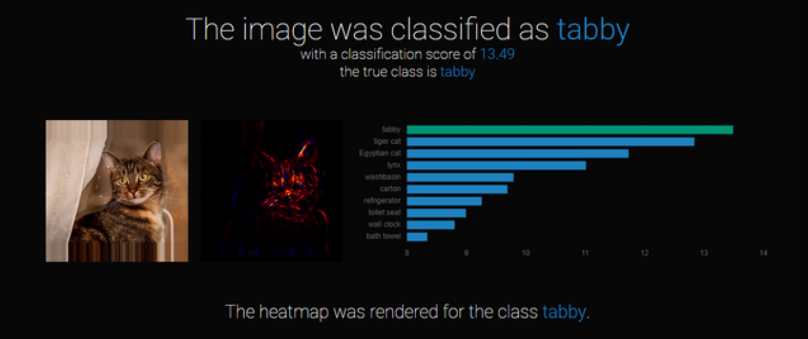
What are Salient Maps?
Salient (adj.): influential
We can see which pixels our model more prominently use to classify images.
The lighter the color the more salient the pixels are in determining what the image is
Notes:
Katherine

Slide 15
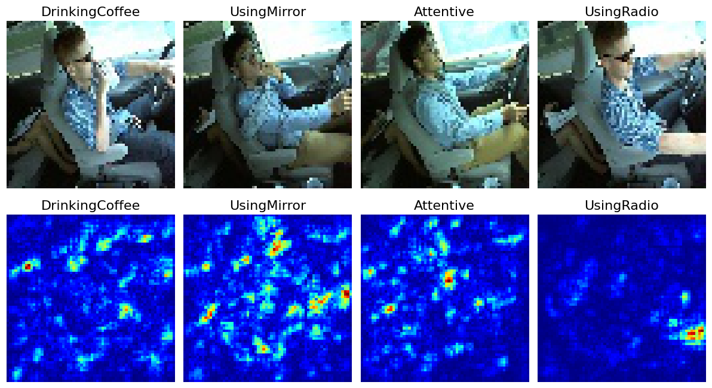
Using Salient Maps
Using our previous CNN model, we can visualize our salient pixels.
We can see that in the UsingRadio category, the hand reaching for the radio is an important determining factor for our model.
Notes:
Katherine

Slide 16
Confusion Matrix
“how accurate were we on the attentive category?”
“how accurate were we on the distracted images?”
Actual Values
“how much of the attentive drivers were confused for distracted driving?”
Positive(1)
Negative(0)
True Positive (TP) | False Positive (FP)
False Negative (FN) | True Negative (TN)
When using VGG16, we want to minimize the False Negatives:
0 = Attentive Driving
1 = Distracted Driving
Positive(1)
Predicted Values
Negative(0)
Notes:
Katherine

Slide 17
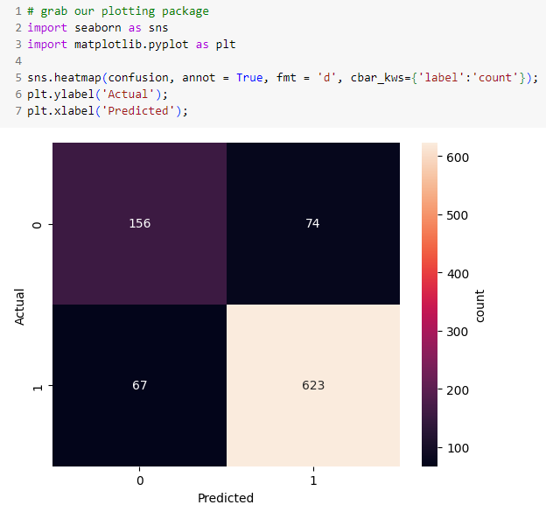
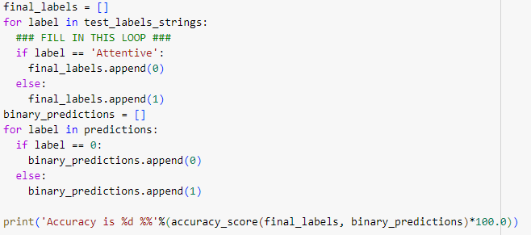
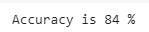
Confusion Matrix
First, we separate the Attentive labels with the others(UsingRadio, UsingMirror, DrinkingCoffee) into a binary classification with 0 and 1.
Then, we can see the overall accuracy and the amount of TPs, FPs, FNs, and TNs. We can see from our chart that we have the least amount of FNs, which is good.
Notes:
Katherine

Slide 18


Precision and Recall
Percentage of positive identifications that were actually positive
Percentage of positives that were identified correctly
Recall =
TP/ (TP+FN)
Precision = TP/ (TP+TN)
Conclusion: there are more TN than FN
Notes:
Katherine

Slide 19
Thank you for Listening!

